Slide 1
5-1 DIGITAL-TO-ANALOG CONVERSION
Digital-to-analog conversion is the process of changing one of the characteristics of an analog signal based on the information in digital data.
Topics discussed in this section:
Aspects of Digital-to-Analog Conversion Amplitude Shift Keying Frequency Shift Keying
Phase Shift Keying
Quadrature Amplitude Modulation

Slide 2
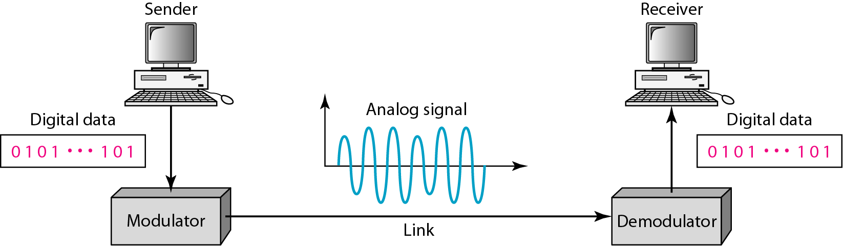
Figure 5.1 Digital-to-analog conversion [1]

Slide 3
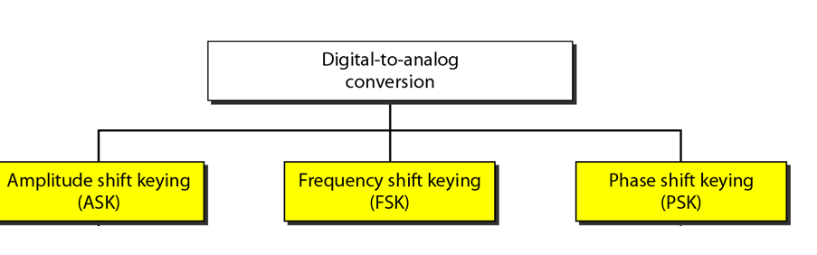
Figure 5.2 Types of digital-to-analog conversion [1]

Slide 4

Note
Bit rate is the number of bits per second. Baud rate is the number of signal
elements per second.
In the analog transmission of digital data, the baud rate is less than or equal to the bit rate.

Slide 5
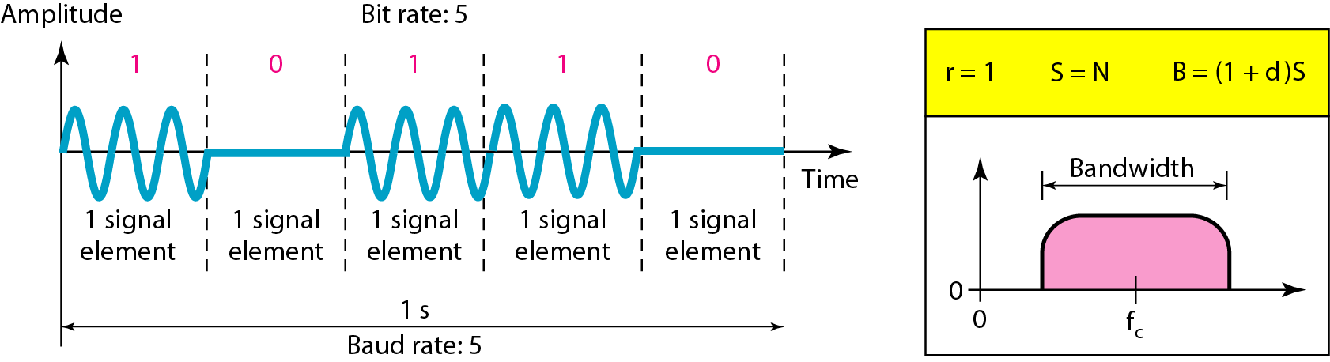
Figure 5.3 Binary amplitude shift keying [1]

Slide 6
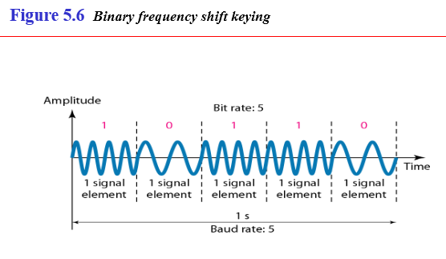

Slide 7
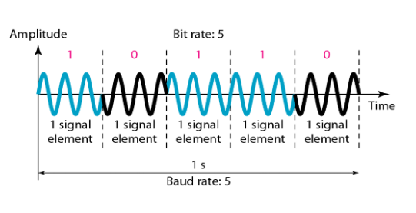
Figure 5.9 Binary phase shift keying [1]

Slide 8
Note
Quadrature amplitude modulation is a combination of ASK and PSK.

Slide 9
Note
Bandwidth utilization is the wise use of available bandwidth to achieve specific goals.
Efficiency can be achieved by multiplexing; privacy and anti-jamming can be achieved by spreading.

Slide 10
MULTIPLEXING
Whenever the bandwidth of a medium linking two devices is greater than the bandwidth needs of the devices, the link can be shared. Multiplexing is the set of techniques that allows the simultaneous transmission of multiple signals across a single data link. As data and telecommunications use increases, so does traffic.
Topics discussed in this section:
Frequency-Division Multiplexing Wavelength-Division Multiplexing Synchronous Time-Division Multiplexing
Statistical Time-Division Multiplexing

Slide 11
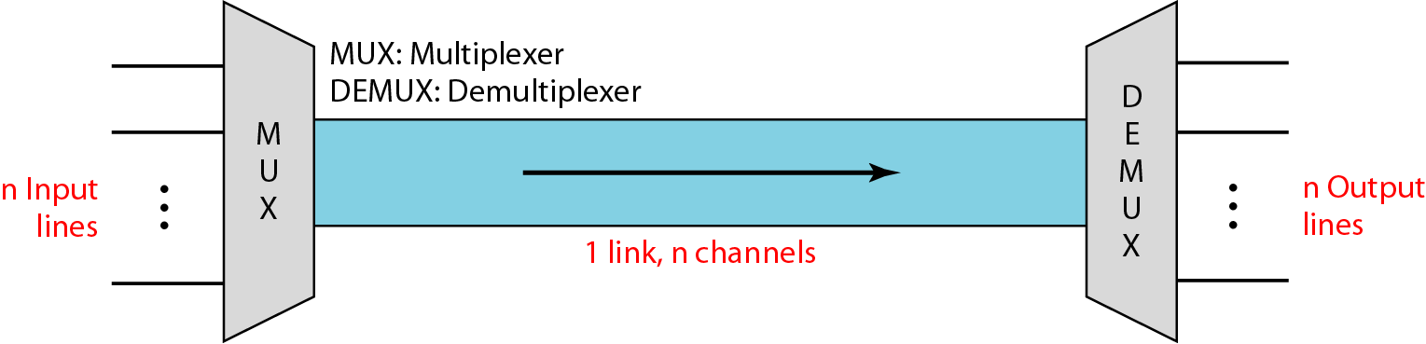
Figure Dividing a link into channels [1]

Slide 12
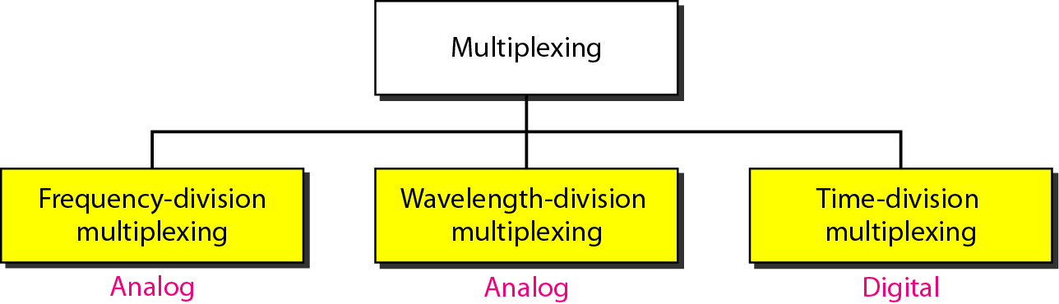
Categories of multiplexing

Slide 13
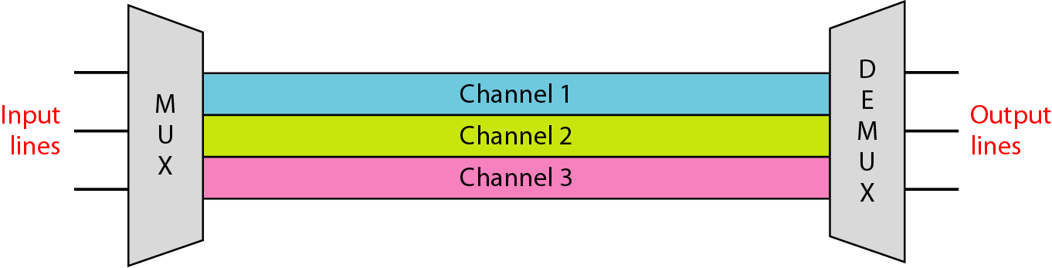
Frequency-division multiplexing [1]

Slide 14
Note
FDM is an analog multiplexing technique that combines analog signals.

Slide 15
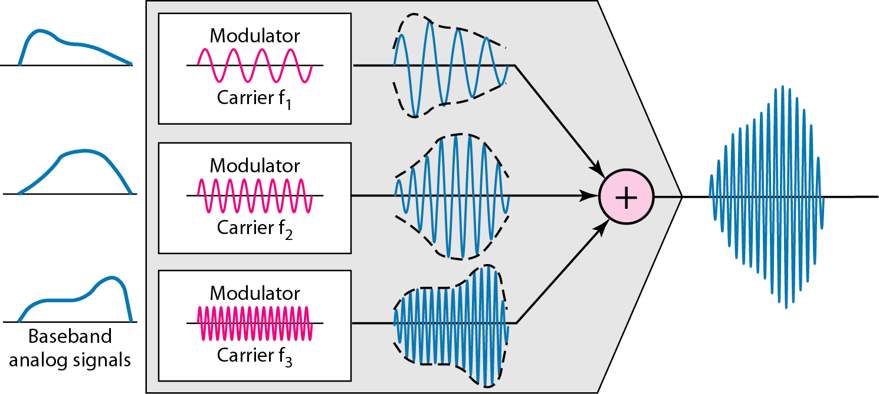
FDM process [1]

Slide 16
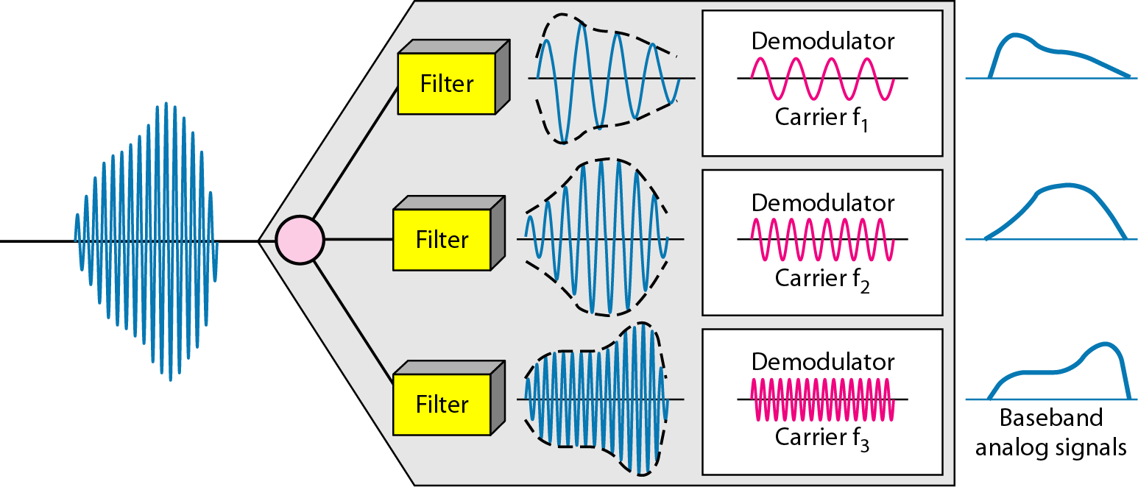
FDM demultiplexing example [1]

Slide 17
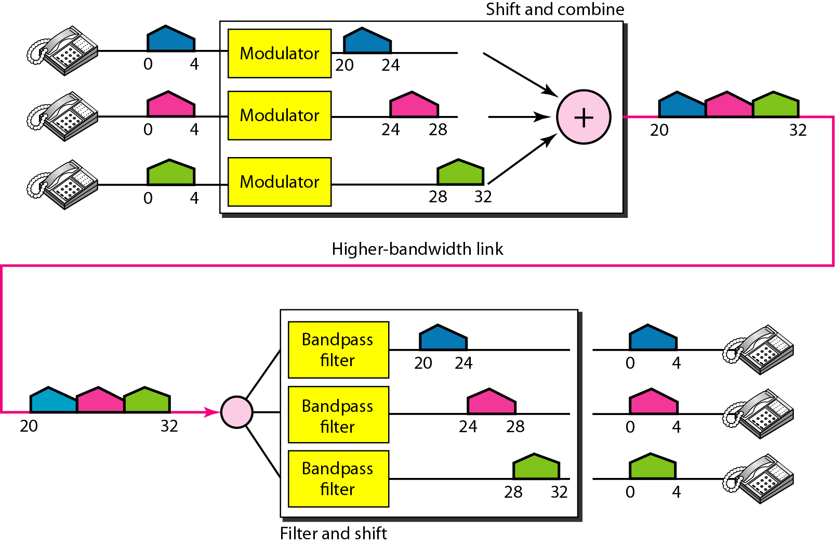
Figure 6.6 Example 6.1 [1]

Slide 18
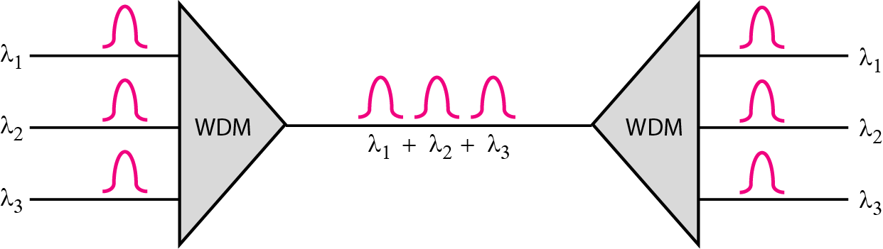
Figure 6.10 Wavelength-division multiplexing [1]

Slide 19
Note
WDM is an analog multiplexing technique to combine optical signals.

Slide 20
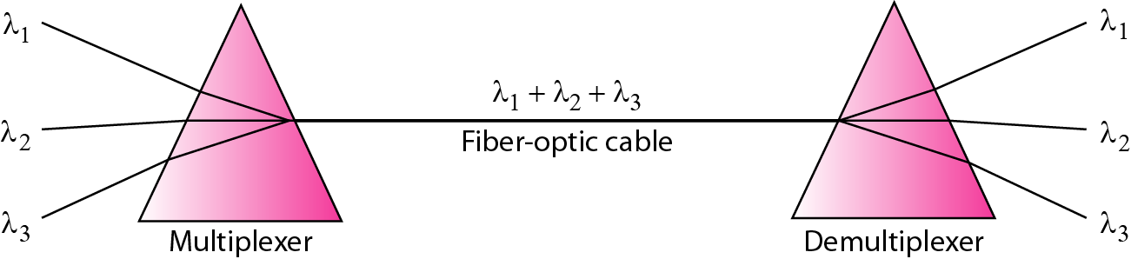
Figure 6.11 Prisms in wavelength-division multiplexing and demultiplexing [1]

Slide 21
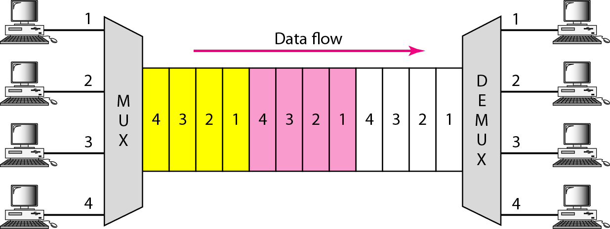
Figure 6.12 TDM [1]

Slide 22
Note
TDM is a digital multiplexing technique for combining several low-rate channels into one high-rate one.

Slide 23
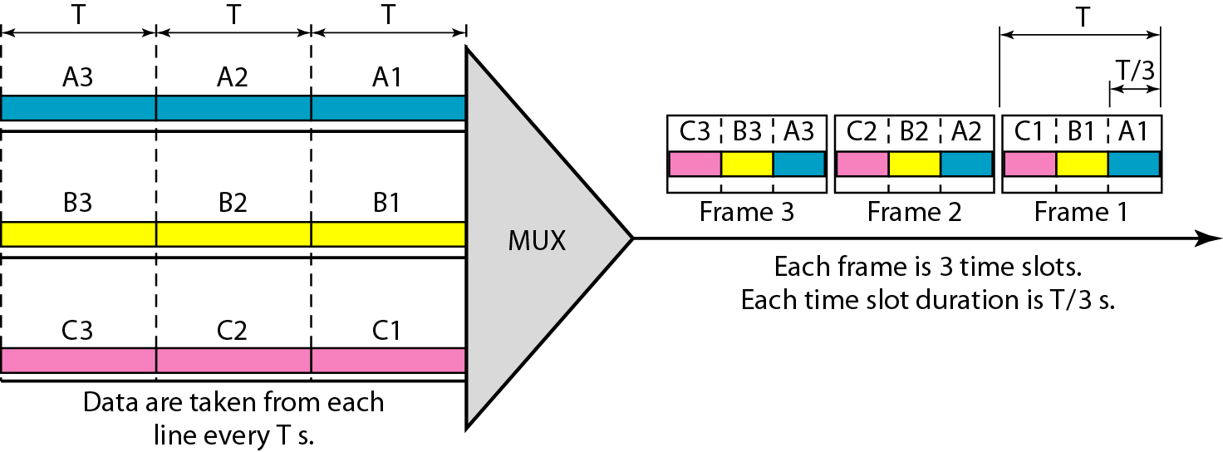
Figure 6.13 Synchronous time-division multiplexing [1]

Slide 24
Note
In synchronous TDM, the data rate of the link is n times faster, and the unit duration is n times shorter.

Slide 25
Example 6.5
In Figure 6.13, the data rate for each input connection is 3 kbps. If 1 bit at a time is multiplexed (a unit is 1 bit), what is the duration of (a) each input slot, (b) each output slot, and (c) each frame?
Solution
We can answer the questions as follows:
a. The data rate of each input connection is 1 kbps. This means that the bit duration is 1/1000 s or 1 ms. The duration of the input time slot is 1 ms (same as bit duration).

Slide 26
Example 6.5 (continued)
b. The duration of each output time slot is one-third of the input time slot. This means that the duration of the output time slot is 1/3 ms.
c. Each frame carries three output time slots. So the duration of a frame is 3 × 1/3 ms, or 1 ms. The duration of a frame is the same as the duration of an input unit.

Slide 27
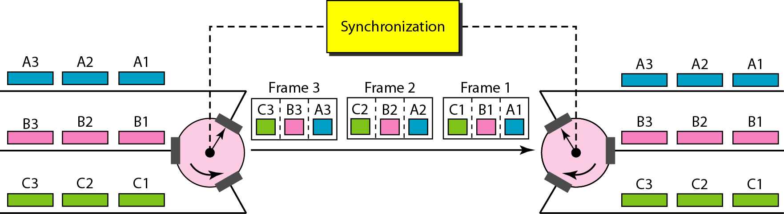
Figure 6.15 Interleaving [1]

Slide 28
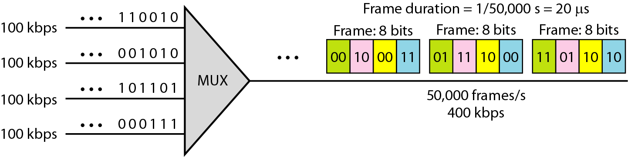

Slide 29
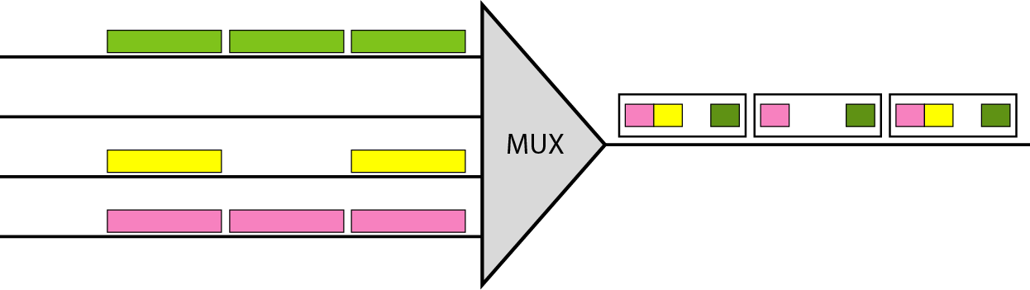
Figure 6.18 Empty slots [1]

Slide 30
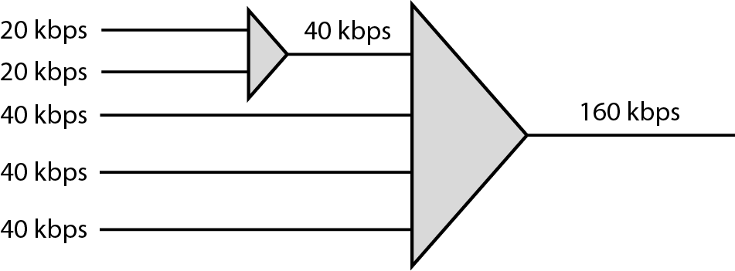
Figure 6.19 Multilevel multiplexing [1]

Slide 31
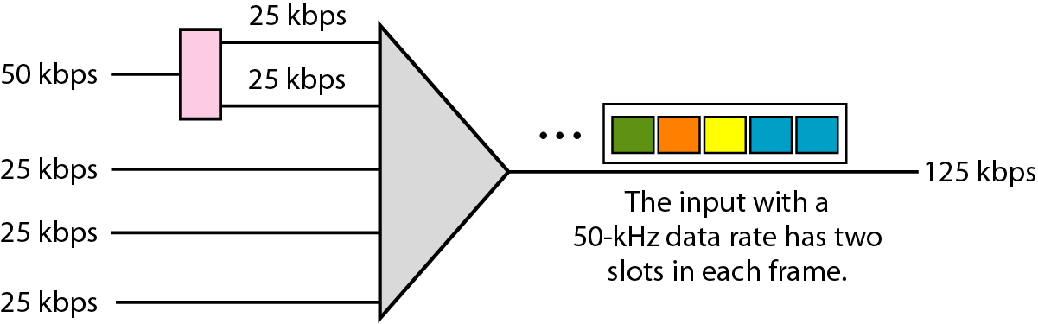
Figure 6.20 Multiple-slot multiplexing

Slide 32
References:
Textbooks
[1] Forouzan, Behrouz A.: “Data Communications & networking”, 4th edition TataMcgraw Hill.
[2] Tanenbaum, Andrew S: “Computer networks”, 4th Edition, Pearson education.
Reference books
[3] Stallings, William : “Data and computer communications”,8th edition,Pearson
Education
[4] Ross, Kurose,“Computer Networking: A top down Approach”, 2nd edition, Pearson
Education.
[5] Coomer,Douglas E.: “Internet working with TCP/IP” , 2 nd edition, Pearson Education
[6] Dave,” Computer Networks, Cengage Learning.
Links:
http://eti2506.elimu.net/Introduction/Books/Data%20Communications%20and%20Networking%20By%20Behrouz%20A.Forouzan.pdf

